Slide 1
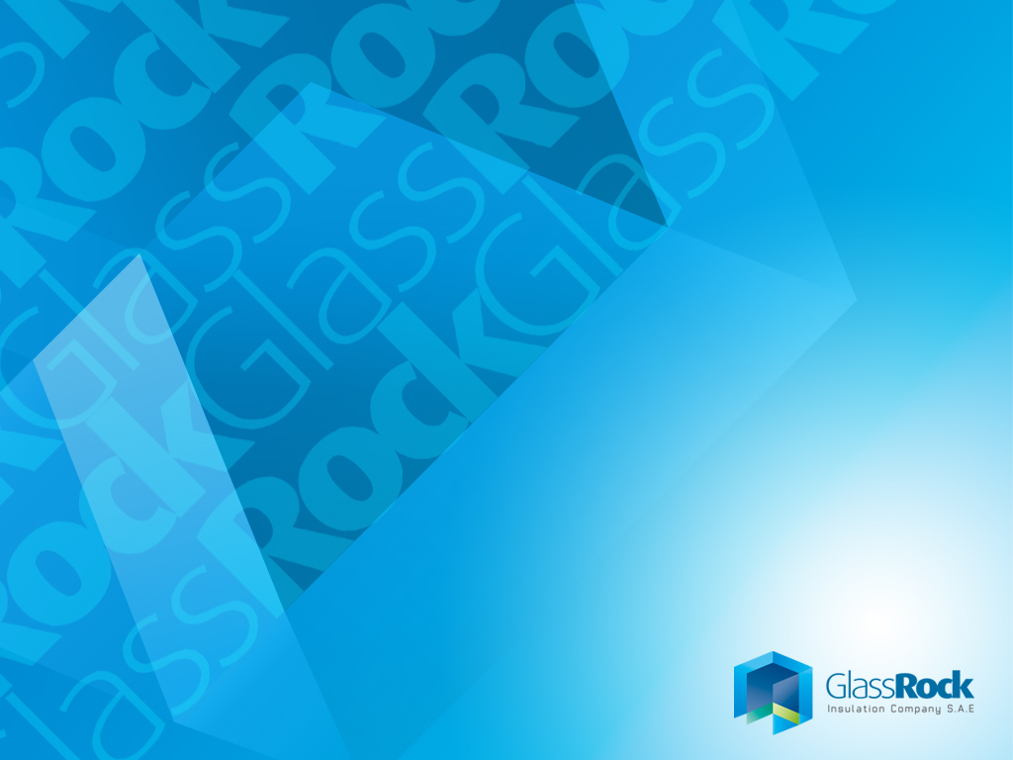
GlassRock
Value Proposition

Slide 2
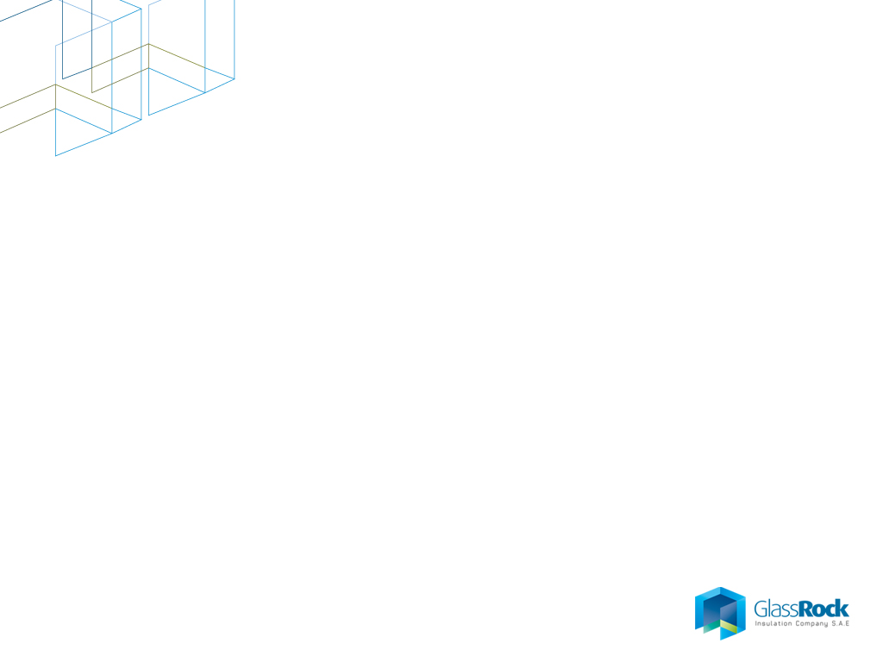
Vision
We aspire to be recognized as a World-Class provider of insulation solutions on both levels, Regional and Global, aiming to create value for our customers and shareholders through our committed and innovative team. Become a company that clients are eager to work with, employees are proud to work for, shareholders satisfied investing in and above all, stakeholders are appreciating its social role.

Slide 3
Mission
Our mission is developing and marketing a thermal and acoustical insulation solutions of appreciated quality by its customers and which will help protecting the environment and saving energy. While doing this, we also provide our employees a platform to learn, grow, innovate and achieve sustainable profitable growth. We are committed to deliver ensuring compliance with the highest ethical, environmental and safety standards

Slide 4
Our Values
Leadership
  integrated along with the Company’s strategy by including both operational and organizational aspects to meet the exact needs of any specific Market.
People
the core value of People is our greatest asset. By recognizing the essential importance of people to the success of our business accordingly, we are aiming to be the preferred company to work with. In return, we will develop people to have passion to excel.
Ethics
maintaining the professional and ethical conduct, not only among our team, but also with our society and stakeholders

Slide 5
Our Values (Ctd)
Constructive partnership
integrated believe that we, to our customers, are partners rather than sellers; and we believe that we are a proactive member in the society
Excellence
the core not only in product but through the services rendered, through research and through development
Care for environment
being a participant in the energetic process of getting individuals and organizations fully and willingly committed to the idea of insulation, to protect the environment and save energy whilst having commonly held human values”

Slide 6
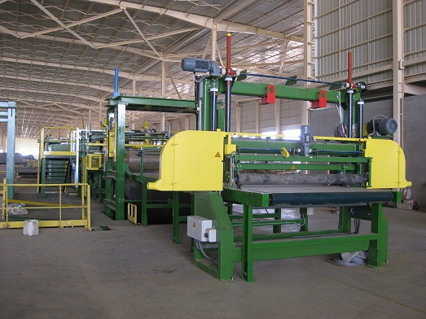
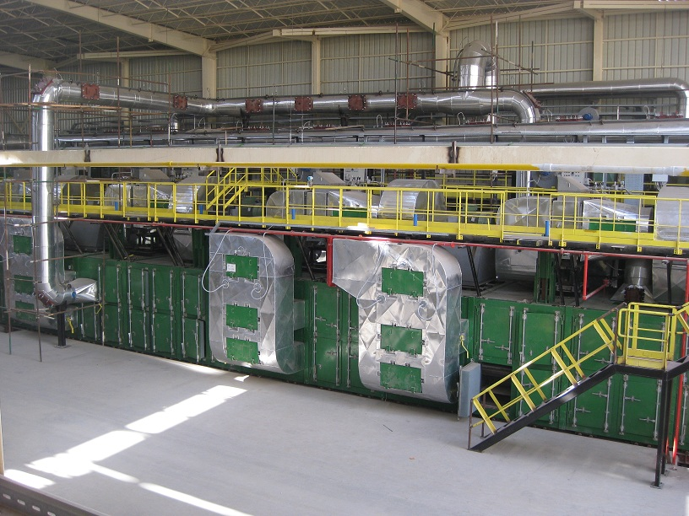
GlassRock overview
  GlassRock was established in 2009 and invested USD 65 million on a Greenfield manufacturing plant with a capacity of 50,000 tons per annum of mineral wool
  The equipment utilises state of the art European technology from Tenova (Italy). The plant includes two lines: 30,000 tons p.a. rock wool line and 20,000 tons p.a. glass wool line
  The facility lies over 120,000m2 and is located in El Sadat City, approximately 100kms from Cair and has been established as a Special Duty Free Zone.

Slide 7
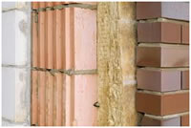
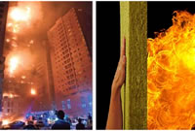
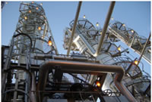
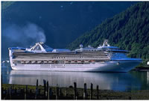
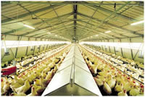
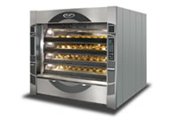
What for?
Thermal, acoustic and Fire barrier
Dimensionally stable and water repellent
Insulates new and existing buildings of all types, large diameter pipes, tanks and vessels, boilers and turbines, critical marine and offshore installations.
Used in various other sectors: household appliances, caravans, cold storages, automotive industries as well as in the agricultural sector where they are utilized as fertilizers and pests’/insects’ killers.

Slide 8
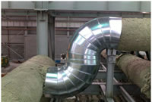
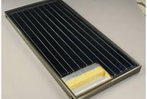
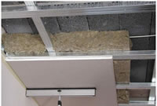
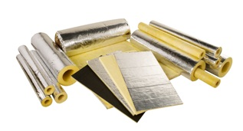
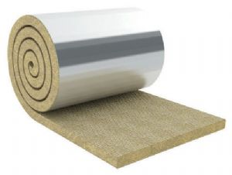
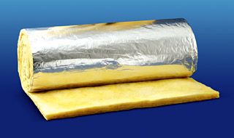
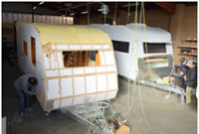
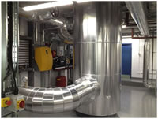
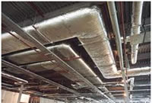
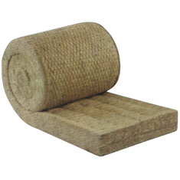
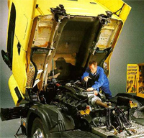
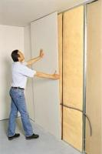
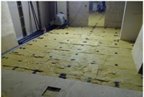
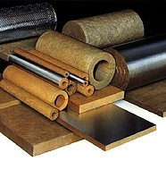
Products & applications

Slide 9
Utilization

Slide 10
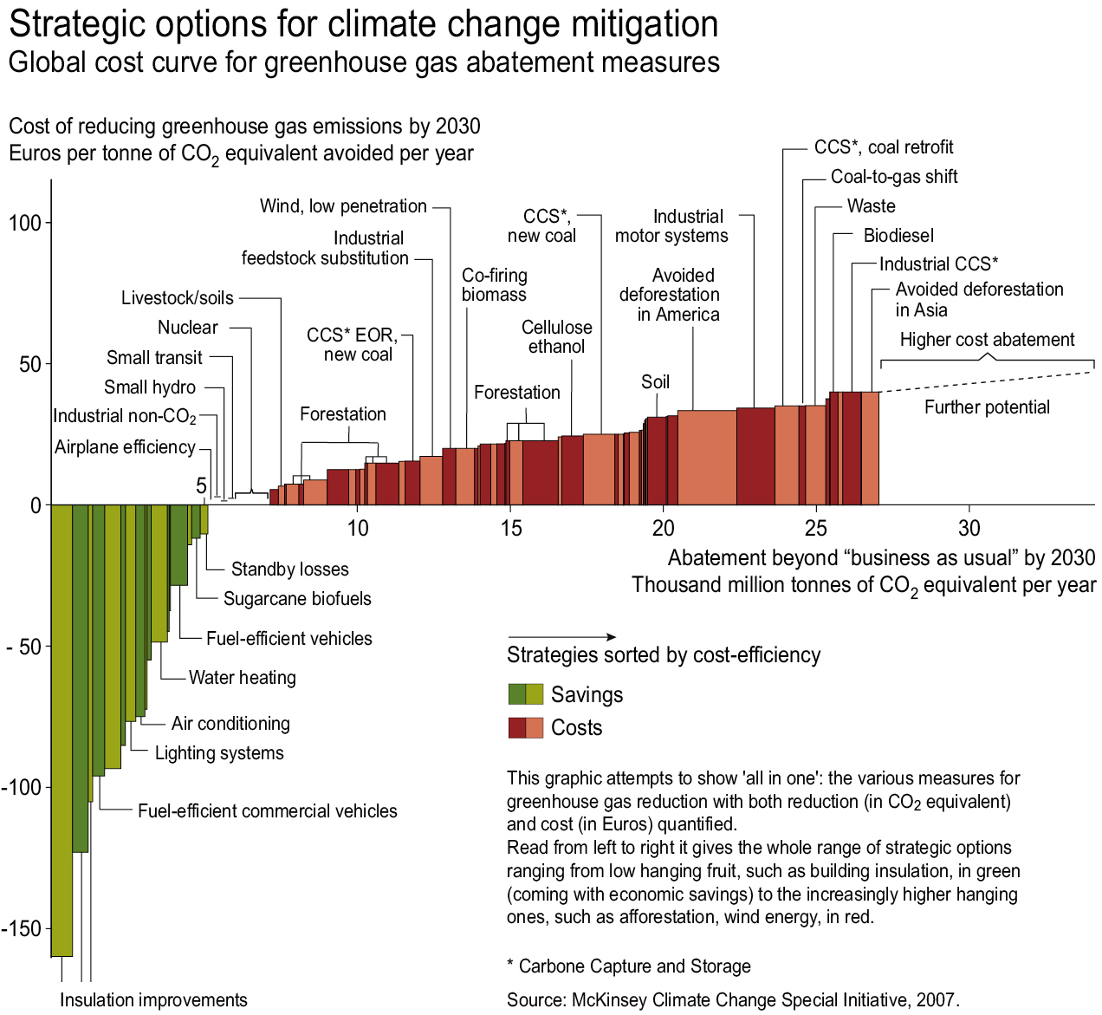
Best solution for CO2

Slide 11
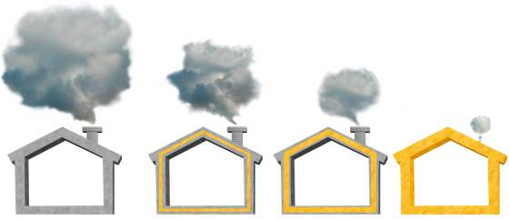
Energy Savings
Built from 1950 to 1975: insufficient insulation
Current
regulations rate
Low-energy house
Passive house
30 kg/m²a
60 kg/m²a
10 kg/m²a
2 kg/m²a
CO2 Emissions
Energy consumption in liters heating or cooling oil per m² and year
25 - 30 l
10 - 15 l
4 - 5 l
1.5 l

Slide 12
Energy Savings
1 m3 raw material ➔ 150 m3 Glass wool
Business as usual
EPS, XPS, PIR, PUF, Phenolic foams are 100% Oil related products
Our Value Proposition
Up to 80% recycled waste glass
Raw materials such Sand, Soda Ash, Limestone, Dolomite and Basalt are virtually inexhaustible resources
The natural raw materials are only produced in small open-cast mines. The result: an extraordinarily favorable ratio between production energy invested and energy savings realized,

Slide 13
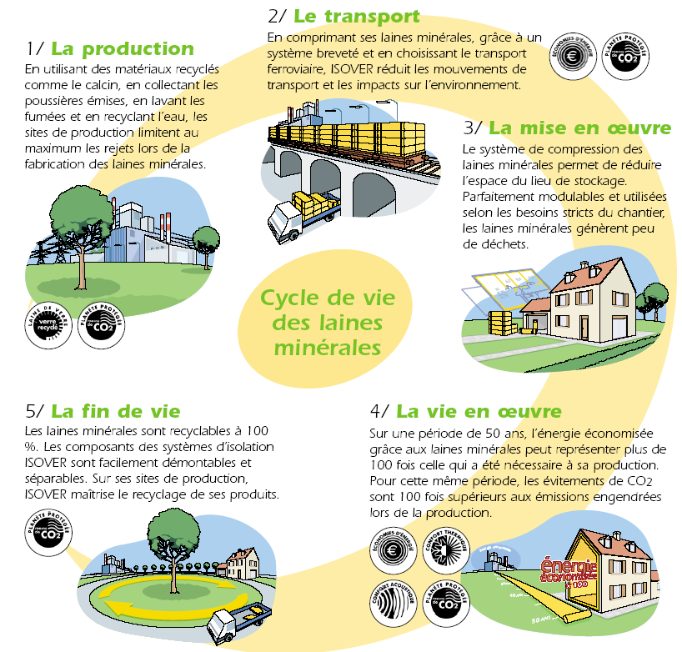
Sustainability
Production:
Up to 80% recycled glass
R.M. Naturally abundant
Collection of dust
Fume washing
Process water recycling
Limited solid disposal
Transportation
High Compression Ratio
Minimized volume
Reduced impact on the environment

Slide 14

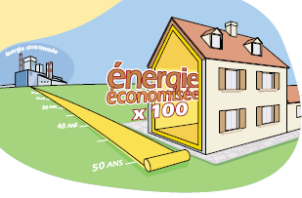
Sustainability
Application
High Compression
Minimized storage space
Little waste thanks
to compressibility
End of Life Time
The mineral wool could
be 100% recycled
The Life Cycle
> 50 years life time
Saves 12 times as much energy
per kg in its first year in place as the
energy used to produce it.

Slide 15
Performance
Business as usual
EPS, XPS, PIR, PUF, Phenolic foams are rigid
Foams not compressible
Foams have poor fire and acoustic performances, are not recyclable and have poor ageing (shrink over time)
Our Value Proposition
Compressed up to 8 times
50 % storage and transport savings due to high compressibility
Mineral wool is flexible, fitting any space = little scrap
Easy to install, higher performance, no void space
Non combustible, good acoustic insulation
Safe and more comfortable living conditions
Multi-purpose use, re-useable, recyclable
Dimensionally stable, high tensile strength

Slide 16

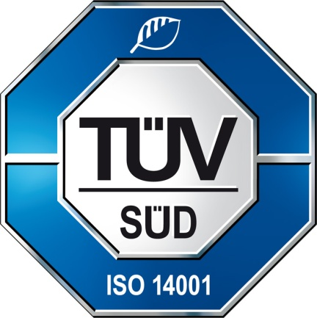

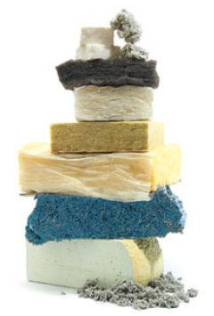
Thank You

